Slide 1
Trusts Law
Week 1: Introduction to the trust
Dr Johanna Jacques

Slide 2
‘Reading’ (for) your Law Degree
Independent study is a vital skill that is important to develop for your future career, regardless of which professional path you choose.
Most of the teaching and learning on all modules takes place outside the classroom (i.e. preparing for teaching commitments, preparing for assessments, carrying out research, further reading etc).
Remember, a 20-credit module translates roughly to 200 hours of work! Only a fraction of that will be in class.
Organise your time carefully and strategically, take responsibility for your learning and seek support if you are struggling from your academic advisor or, on a specific module, from module leaders, tutors or lecturers during their weekly Academic Support and Feedback Hours.

Slide 3
This week
This week:
What is a trust?
How is the trust distinguished from other legal arrangements?
Different types of trust

Slide 4
Learning objectives this week
To understand the form of the trust as a legal arrangement*
To learn about the elements of a trust
*Within the context of other legal arrangements
To note that there are different types of trust

Slide 5
Ownership vs. property
Ownership as a normative concept that needs legal substantiation through property rights
Law and equity sometimes have a different view of where ownership lies
A closer look at some legal terms:
  Absolute ownership
  Property law
  Property
  Property rights
  Proprietary

Slide 6
Definition 1
J. Penner, The Idea of Property in Law:
‘A trust exists when a particular fund of property is held by a legal owner ‘on trust’ for a cestui que trust or beneficiary, which means roughly the following: the legal owner has all the legal powers to deal with the trust property, but he must do so entirely for the benefit of the cestui, who is said to have the benefit or enjoyment of the property.’

Slide 7
Definition 2
S. Gardner, An Introduction to the Law of Trusts:
‘A trust is a situation in which property is vested in someone (a trustee), who is under legally recognized obligations, at least some of which are of a proprietary kind, to handle it in a certain way, and to the exclusion of any personal interest. These obligations may arise either by conscious creation by the previous owner of the property (the settlor), or because some other legally significant circumstances are present.’

Slide 8
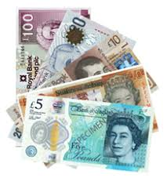
The trust
Legal title
Settlor
Trustee (owner at law)
Equitable interest
Property
Beneficiary (owner in equity)

Slide 9

Legal vs. equitable
Cannot use property for their own benefit
Trustee (owner at law)
If transferred to
Bona fide
purchaser for value
without notice
(BFPFVWN)
Property
Beneficiary (owner in equity)
defeats ownership
claim of
= limits to ownership at law and in equity

Slide 10
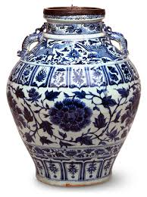
Proprietary vs. obligational
Settlor
Trustee
Trust instrument
= contract?
Personal right
3rd party
(not BFPFVWN)
Beneficiary
Proprietary right

Slide 11
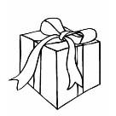




The trust compared to other legal arrangements
An absolute gift
A Legal chose in action, such as a debt
Bailment
Contract
Corporation
Agency
£$€

Slide 12

Three types of trust
Public trusts
Private trusts
a) Express (fixed or discretionary)
b) Implied (resulting or constructive)

Slide 13
A simple question
Jack and Linda are invited to a dinner party. On the way they stop to buy a bottle of wine. In front of the shop, they count how much cash they have between them. Jack has £2, Linda has £8. Jack goes into the shop and buys a £10 bottle of wine. Linda waits outside.
Who owns the wine?
A - Jack
B - Linda
C - Jack and Linda

Slide 14
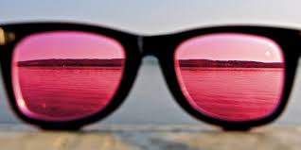
The answer
At law: Jack
In equity: Jack and Linda, according to their proportional contributions to the purchase price

Slide 15
Recap
Recap:
The trust takes account of a substantive conception of ownership to split legal and equitable interests between two parties.
The trust can be distinguished from other legal arrangements due to its unique mix of obligation and property features.
Next week: You will be introduced to the history of the trust form in English law.

Slide 16
Activity
The trust is an important tool in international wealth management. Look at the news reporting on the ‘Pandora papers’ and note when trust structures are mentioned. This will give you an idea of the use of the trust in offshore jurisdictions:
https://www.theguardian.com/news/series/pandora-papers

